Slide 1
Directory Structure
Ms. Manya Gidwani

Slide 2
Directory Structure
A directory is a container that is used to contain folders and files. It organizes files and folders in a hierarchical manner.
Operations Performed on Directory
Search for a file
Create a file
Delete a file
List a directory
Rename a file
Traverse the file system

Slide 3
Organize the Directory (Logically) to Obtain
Efficiency – locating a file quickly
Naming – convenient to users
Two users can have same name for different files
The same file can have several different names
Grouping – logical grouping of files by properties, (e.g., all Java programs, all games, …)

Slide 4
There are several logical structures of a directory, these are given below.

Slide 5
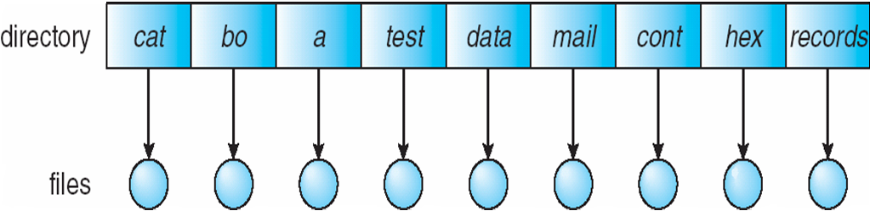
Single-Level Directory
A single directory for all users
The single-level directory is the simplest directory structure.
In it, all files are contained in the same directory which makes it easy to support and understand.

Slide 6
Disadvantages
Advantages
Since it is a single directory, so its implementation is very easy.
If the files are smaller in size, searching will become faster.
The operations like file creation, searching, deletion, updating are very easy in such a directory structure.
There may chance of name collision because two files can not have the same name.
Searching will become time taking if the directory is large.
This can not group the same type of files together.

Slide 7
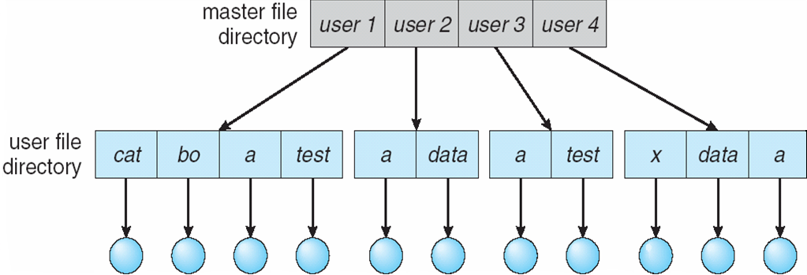
Two-Level Directory
Separate directory for each user
Path name
Can have the same file name for different user
Efficient searching
No grouping capability

Slide 8
Advantages:
We can give full path like /User-name/directory-name/.
Different users can have the same directory as well as the file name.
Searching of files becomes easier due to pathname and user-grouping.
Disadvantages:
A user is not allowed to share files with other users.
Still, it not very scalable, two files of the same type cannot be grouped together in the same user.

Slide 9
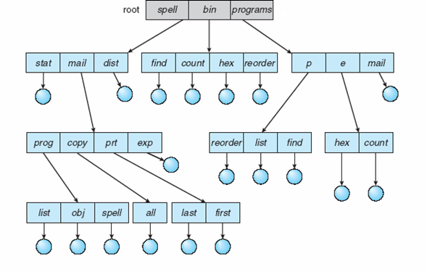
Tree-Structured Directories

Slide 10
Advantages:
Very general, since full pathname can be given.
Very scalable, the probability of name collision is less.
Searching becomes very easy, we can use both absolute paths as well as relative.
Disadvantages:
Every file does not fit into the hierarchical model, files may be saved into multiple directories.
We can not share files.
It is inefficient, because accessing a file may go under multiple directories.

Slide 11
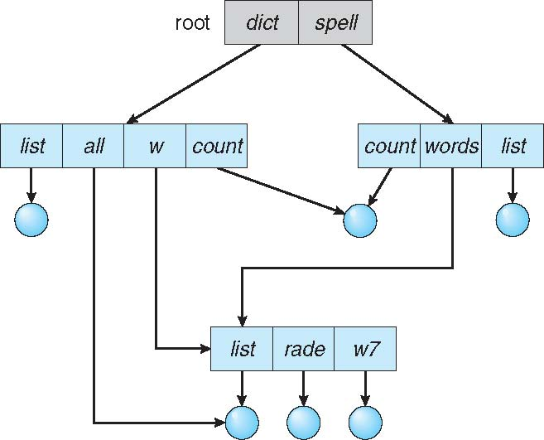
Acyclic-Graph Directories
An acyclic graph is a graph with no cycle and allows us to share subdirectories and files.
It is used in the situation like when two programmers are working on a joint project and they need to access files

Slide 12
Advantages:
We can share files.
Searching is easy due to different-different paths.
Disadvantages:
We share the files via linking, in case deleting it may create the problem,
If the link is a soft link then after deleting the file we left with a dangling pointer.
In the case of a hard link, to delete a file we have to delete all the references associated with it.

Slide 13
Thankyou

